Slide 1

7th Grade Math
Unit 2, Lesson 3 Rewriting Numbers in Equivalent Forms Volume 1, pg. 47

Slide 2


Benchmark
MA.7.NSO.1.2
Rewrite rational numbers in different but equivalent forms including fractions, mixed numbers, repeating decimals, and percentages to solve mathematical and real-world problems.
volume 1, pg. 47

Slide 3
Integrated Mathematical Thinking and Reasoning Standards
MA.K12.MTR.4.1 Engage in discussions that reflect on the mathematical thinking of self and others.
MA.K12.MTR.5.1 Use patterns and structure to help understand and connect mathematical concepts.
volume 1, pg. 47

Slide 4

Learning Targets
I can rewrite rational numbers in different but equivalent forms, including repeating decimals.
I can explore patterns in fractions whose decimal equivalent is repeating.
volume 1, pg. 47

Slide 5

Warm-Up
volume 1, pg. 47

Slide 6
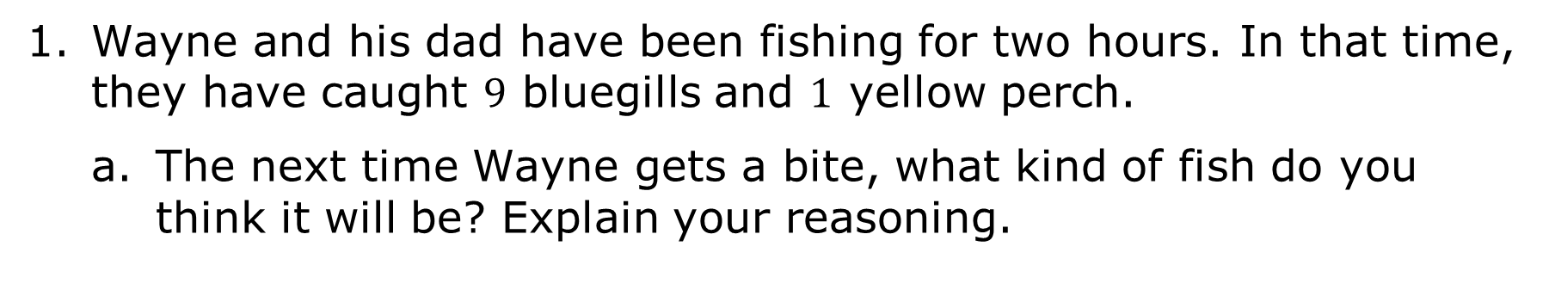
2.3.1 Warm-Up: Gone Fishing
Wayne and his dad have been fishing for two hours. In that time, they have caught $9$ bluegills and $1$ yellow perch.
The next time Wayne gets a bite, what kind of fish do you think it will be? Explain your reasoning.
volume 1, pg. 47

Slide 7
Complete the table to represent the portion of the fish caught in the first two hours that were bluegills in three different ways.
Portion of Fish That are Bluegills
Fraction | Decimal | Percentage
volume 1, pg. 47

Slide 8

Refresher
volume 1, pg. 48

Slide 9

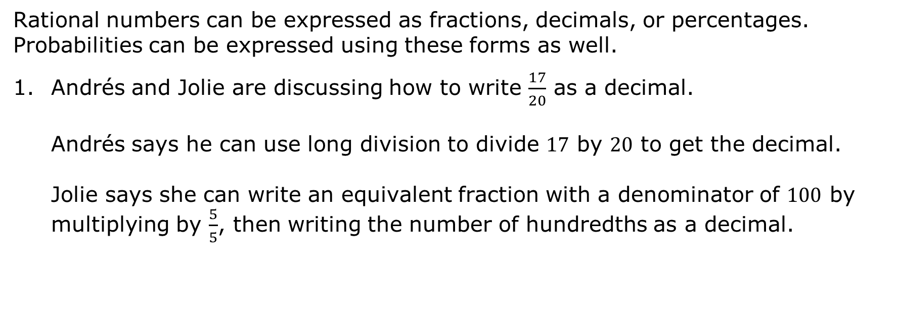
2.3.2 Refresher: Rewriting Rational Numbers in Different Equivalent Forms
Rational numbers can be expressed as fractions, decimals, or percentages. Probabilities can be expressed using these forms as well.
Andrés and Jolie are discussing how to write $\frac{17}{20}$ as a decimal.
Andrés says he can use long division to divide $17$ by $20$ to get the decimal.
Jolie says she can write an equivalent fraction with a denominator of $100$ by multiplying by $\frac{5}{5}$, then writing the number of hundredths as a decimal.
volume 1, pg. 48

Slide 10
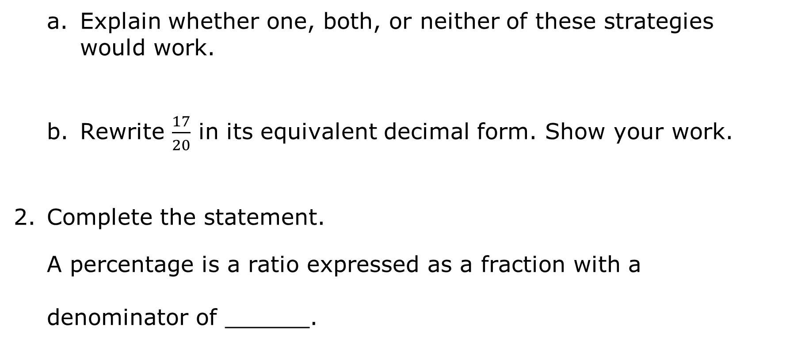
Explain whether one, both, or neither of these strategies would work.
Rewrite $\frac{17}{20}$ in its equivalent decimal form. Show your work.
Complete the statement.
A percentage is a ratio expressed as a fraction with a denominator of ______.
volume 1, pg. 48

Slide 11
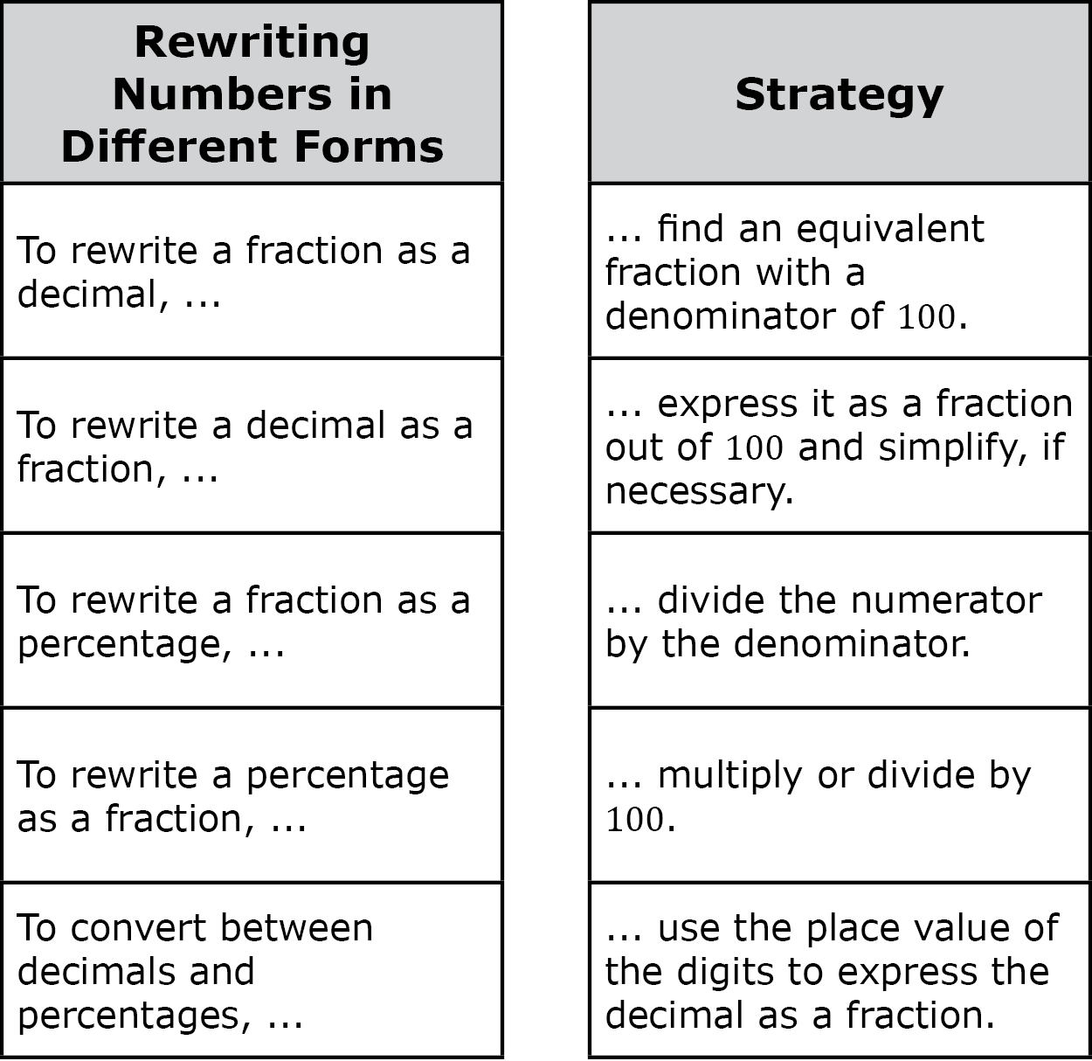
There are many strategies that can be used to rewrite rational numbers in different forms. Some of them are included below.
Work with your partner to match each phrase in the column on the left with a strategy in the column on the right. Draw arrows to make each match.
volume 1, pg. 48

Slide 12
Choose one phrase from the list on the left and complete it using a different strategy than what you matched it with above. Your strategy can be different from those listed above.
volume 1, pg. 48

Slide 13

Guided Instruction
volume 1, pg. 49

Slide 14


2.3.3 Guided Instruction: Repeating Decimals
Rational numbers can be written as a fraction, $\frac{a}{b}$, where $a$ and $b$ are integers and $b≠0$, or as a decimal. In decimal form, rational numbers either terminate or repeat.
A rational number is a real number that can be expressed as a ratio of two integers.
volume 1, pg. 49

Slide 15
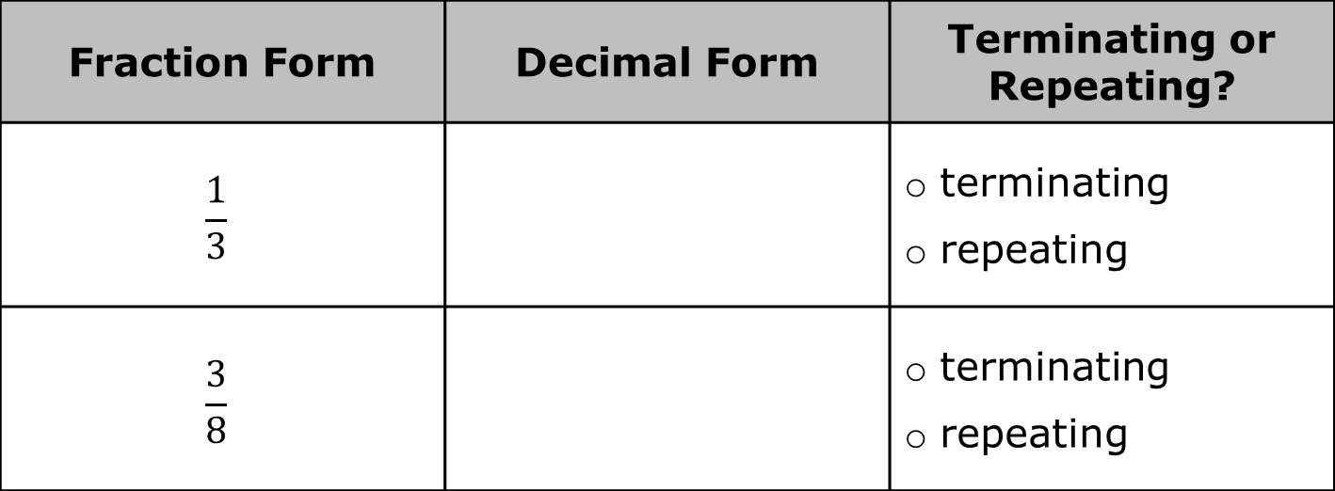
Consider the fractions in the table shown.
Rewrite each fraction in its equivalent decimal form. Then, indicate whether each decimal is a terminating or repeating decimal. If a decimal repeats digits in a pattern, use an ellipse (...) to indicate that the pattern continues.
Fraction Form | Decimal Form | Terminating or Repeating?
$$\frac{1}{3}$$ |  | terminating repeating
$$\frac{3}{8}$$ |  | terminating repeating
volume 1, pg. 49

Slide 16
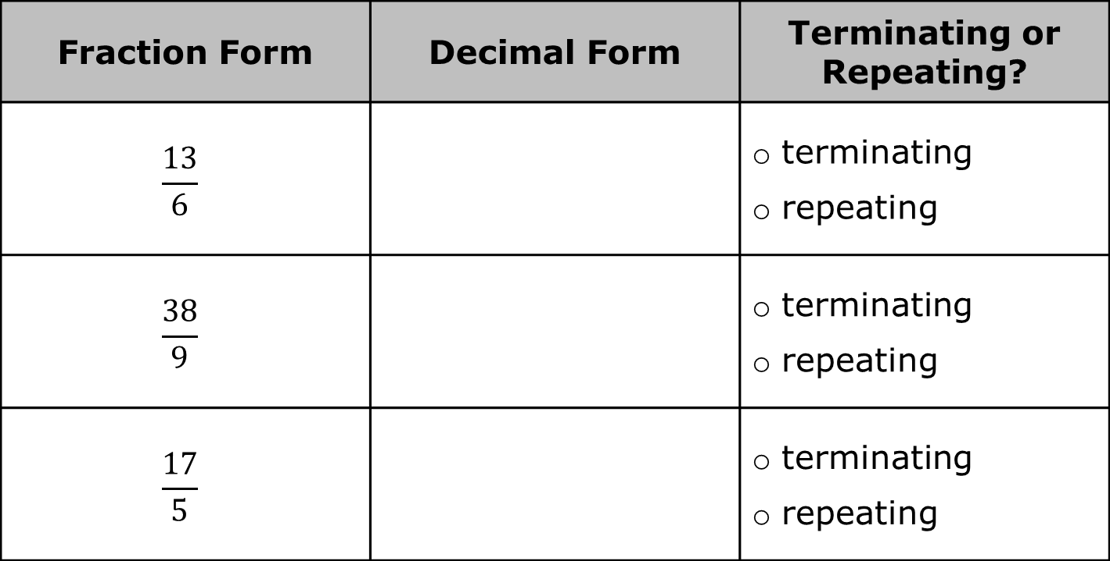
Fraction Form | Decimal Form | Terminating or Repeating?
$$\frac{13}{6}$$ |  | terminating repeating
$$\frac{38}{9}$$ |  | terminating repeating
$$\frac{17}{5}$$ |  | terminating repeating
volume 1, pg. 49

Slide 17
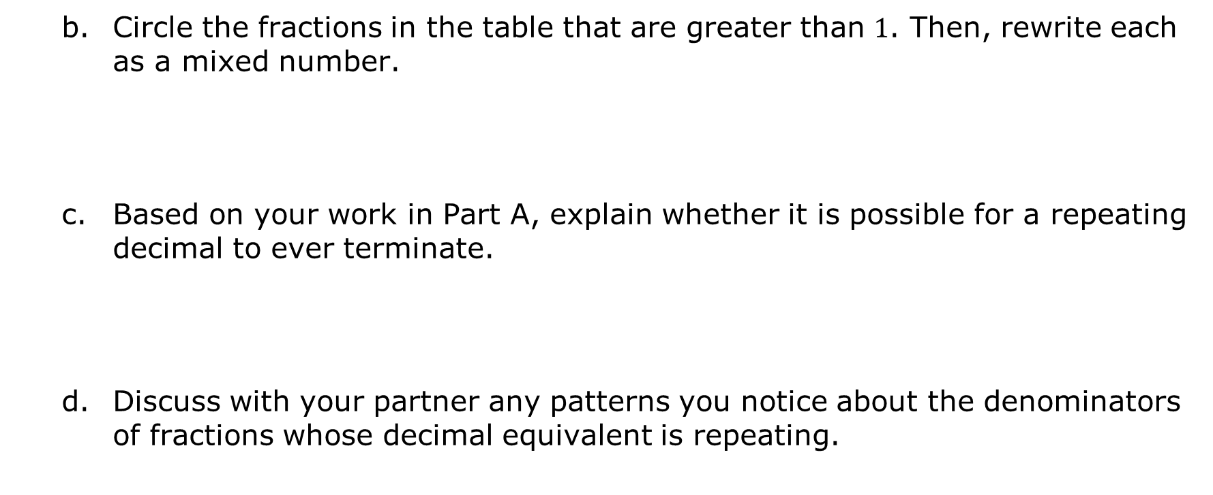
Circle the fractions in the table that are greater than $1$. Then, rewrite each as a mixed number.
Based on your work in Part A, explain whether it is possible for a repeating decimal to ever terminate.
Discuss with your partner any patterns you notice about the denominators of fractions whose decimal equivalent is repeating.
volume 1, pg. 49

Slide 18

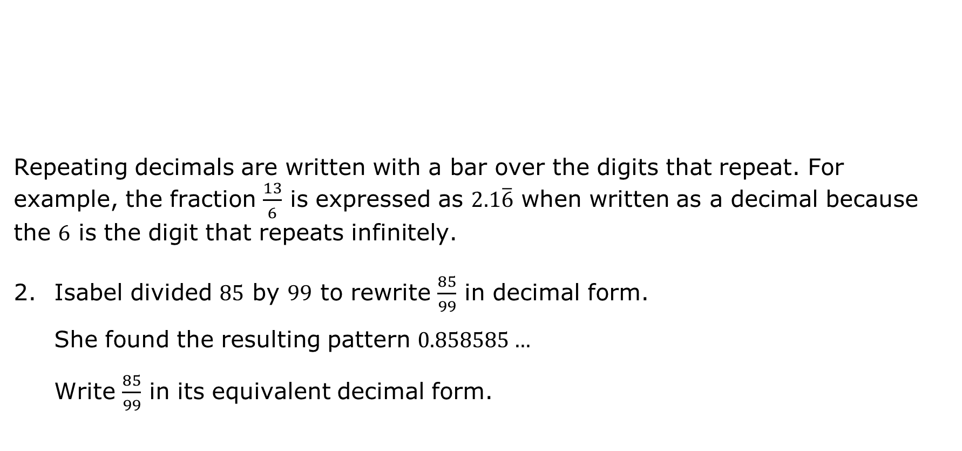
Repeating decimals are written with a bar over the digits that repeat. For example, the fraction $\frac{13}{6}$ is expressed as $2.1\overline{6}$ when written as a decimal because the $6$ is the digit that repeats infinitely.
Isabel divided $85$ by $99$ to rewrite $\frac{85}{99}$ in decimal form. She found the resulting pattern $0.858585…$ Write $\frac{85}{99}$ in its equivalent decimal form.
A number with a decimal that never ends but has a pattern that repeats infinitely is called a repeating decimal.
volume 1, pg. 49

Slide 19

Exploration
volume 1, pg. 50

Slide 20

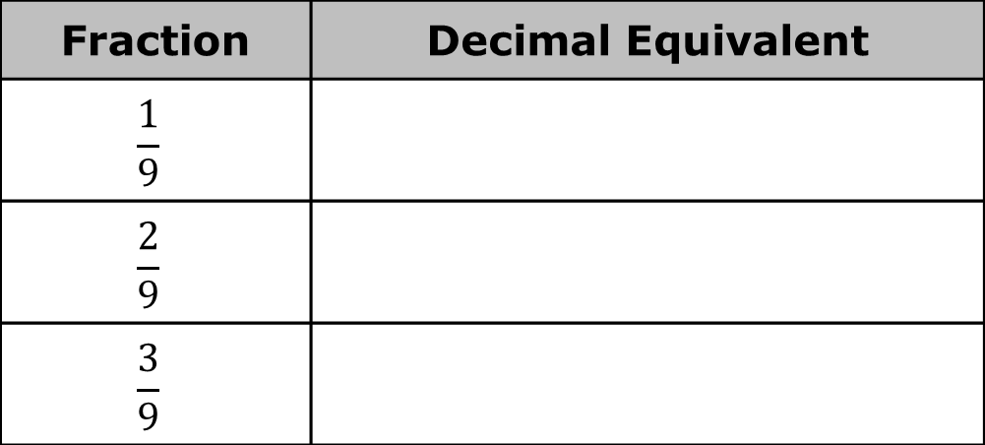
2.3.4 Exploration: Patterns in Repeating Decimals
Work with your partner to complete the following.
Use a scientific calculator to find the decimal equivalent of each fraction.
Fraction | Decimal Equivalent
$$\frac{1}{9}$$
$$\frac{2}{9}$$
$$\frac{3}{9}$$
volume 1, pg. 50

Slide 21
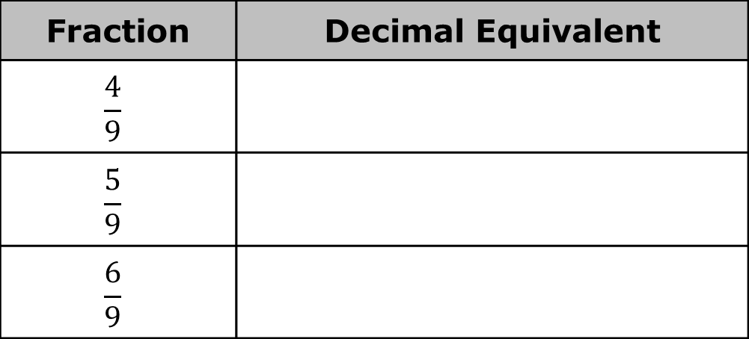
Fraction | Decimal Equivalent
$$\frac{4}{9}$$
$$\frac{5}{9}$$
$$\frac{6}{9}$$
Describe the relationship observed between fractions with a denominator of $9$ and their decimal equivalents.
volume 1, pg. 50

Slide 22
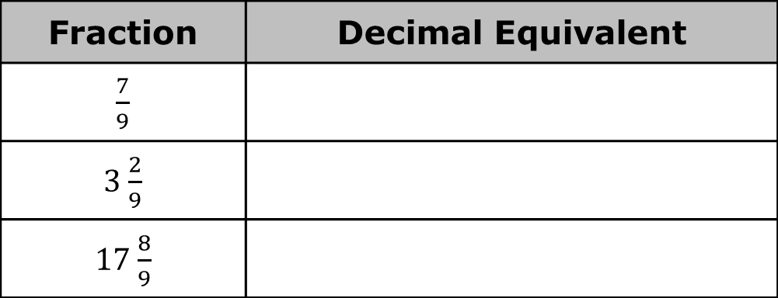
Without performing any calculations, predict the decimal equivalent for each fraction in the table.
Verify your predictions using your calculator.
Fraction | Decimal Equivalent
$\frac{7}{9}$
3 $\frac{2}{9}$
17 $\frac{8}{9}$
volume 1, pg. 50

Slide 23
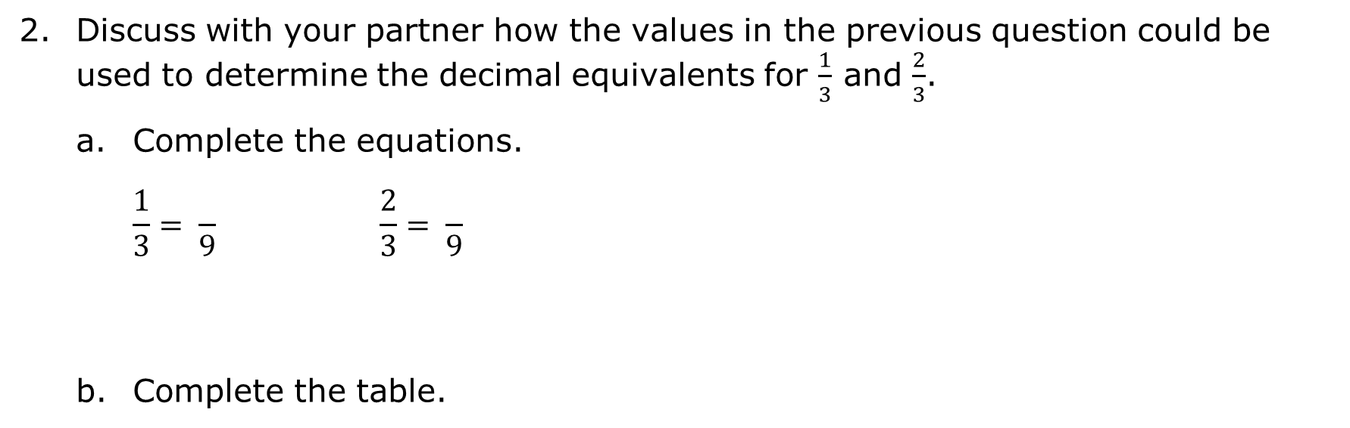

Discuss with your partner how the values in the previous question could be used to determine the decimal equivalents for $\frac{1}{3}$ and $\frac{2}{3}$.
Complete the equations.
$$\frac{1}{3}= \frac{ }{9} \frac{2}{3}= \frac{ }{9}$$
Complete the table.
Fraction | Decimal Equivalent
$\frac{1}{3}$
$\frac{2}{3}$
$\frac{7}{3}= \frac{ }{3}$
volume 1, pg. 50

Slide 24
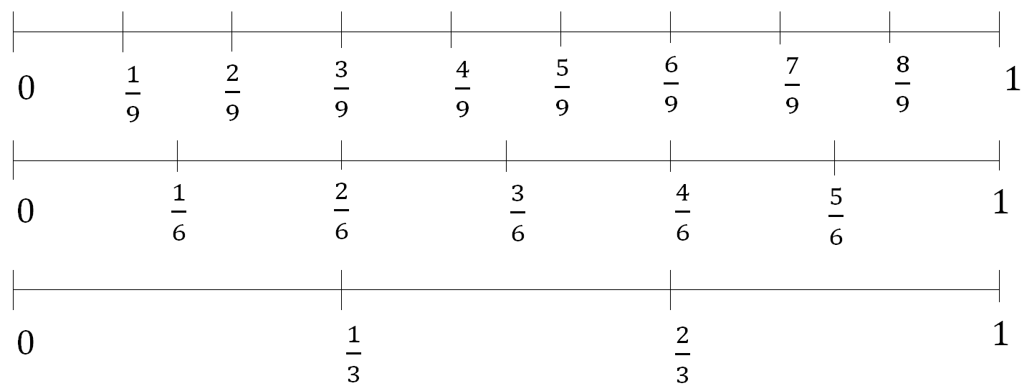

Three number lines are shown.
Explain what the decimal equivalent of $\frac{2}{6}$ is using the number lines.
volume 1, pg. 51

Slide 25
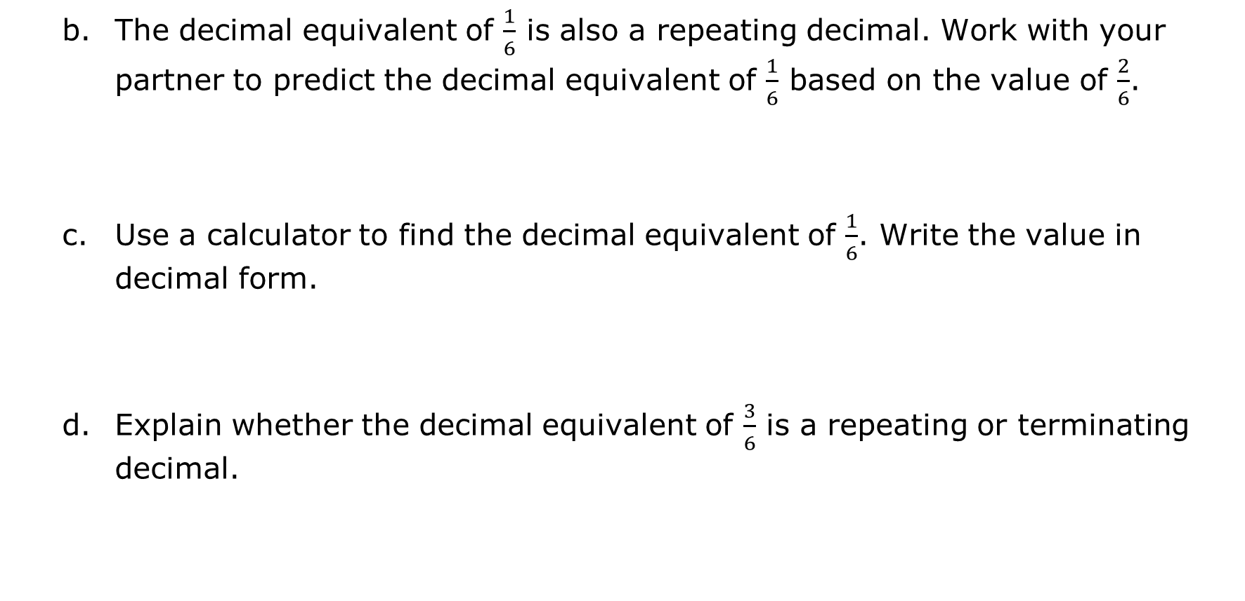
The decimal equivalent of $\frac{1}{6}$ is also a repeating decimal. Work with your partner to predict the decimal equivalent of $\frac{1}{6}$ based on the value of $\frac{2}{6}$.
Use a calculator to find the decimal equivalent of $\frac{1}{6}$. Write the value in decimal form.
Explain whether the decimal equivalent of $\frac{3}{6}$ is a repeating or terminating decimal.
volume 1, pg. 51

Slide 26

Bring It Together
volume 1, pg. 51

Slide 27

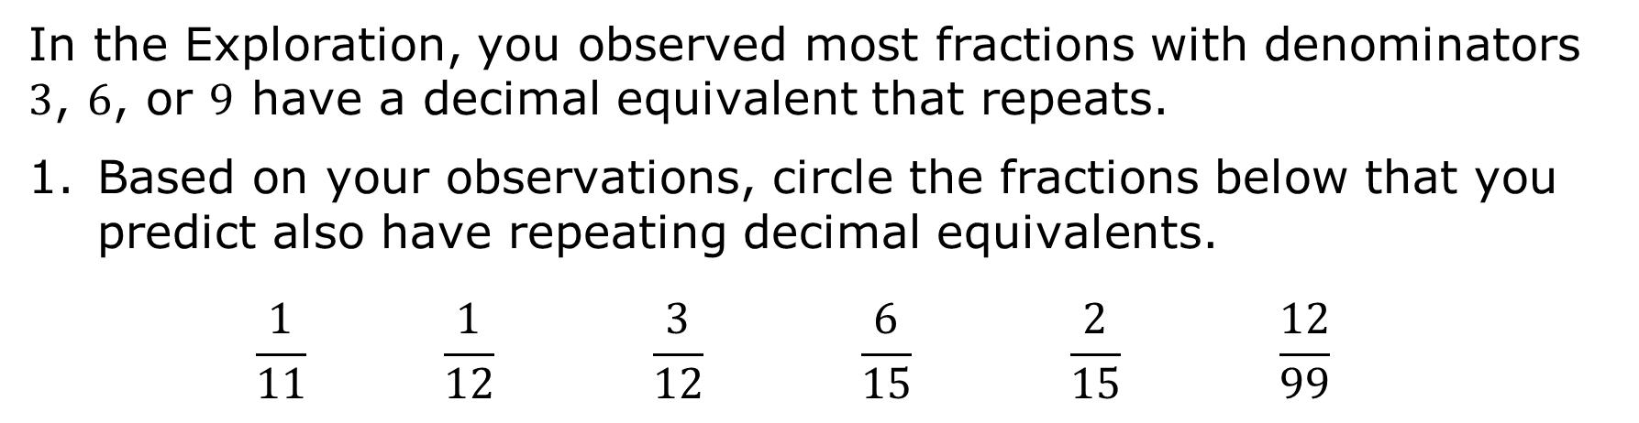
2.3.5 Bring It Together: Patterns in Repeating Decimals
In the Exploration, you observed most fractions with denominators $3$, $6$, or $9$ have a decimal equivalent that repeats.
Based on your observations, circle the fractions below that you predict also have repeating decimal equivalents.
$$\frac{1}{11} \frac{1}{12} \frac{3}{12} \frac{6}{15} \frac{2}{15} \frac{12}{99}$$
volume 1, pg. 51

Slide 28
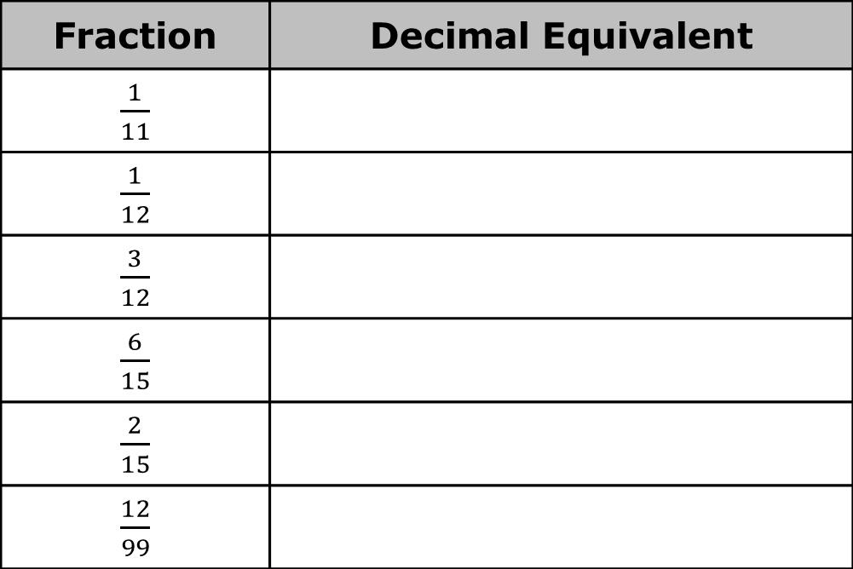
Use a scientific calculator to verify your predictions. Write the decimal equivalent for each fraction in the table.
Make a conjecture about which fractions have decimal expansions that are repeating.
Fraction | Decimal Equivalent
$\frac{1}{11}$
$\frac{1}{12}$
$\frac{3}{12}$
$\frac{6}{15}$
$\frac{2}{15}$
$\frac{12}{99}$
volume 1, pg. 51

Slide 29

Wrap-Up
volume 1, pg. 52

Slide 30
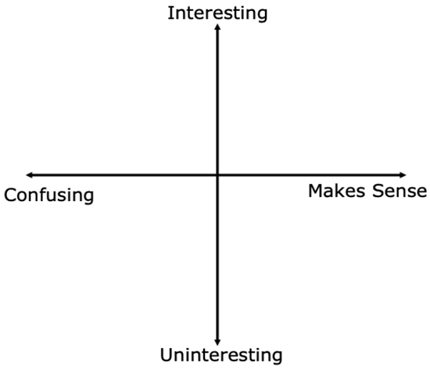
2.3.6 Wrap-Up: Reflection
Plot a point in one of the quadrants below to indicate where you are on today’s learning targets.
Write one question you still have about what you learned today.
volume 1, pg. 52

